Slide 1

The Evolution of the Michigan Activity Pass (MAP) program
2007 to present day

Slide 2

MAP beginnings:
Sponsored by Macy’s
Metro Detroit based program
25 Destinations
179 Public Libraries
3 Library Cooperatives

Slide 3

2009: TLN takes over administration of program
Under TLN administration MAP:
Changes program name from Museum Adventure Pass to Michigan Activity Pass
Moves from print material program to an online program – http://www.michiganactivitypass.info
Goes statewide in 2013

Slide 4
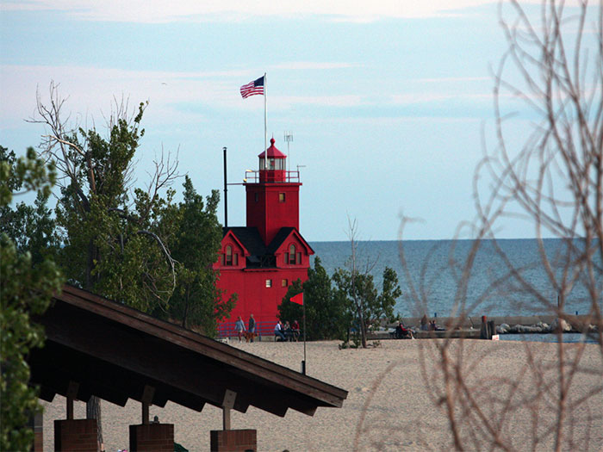

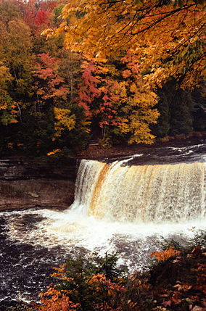
2015-2016:Michigan State Parks added to the program

Slide 5

Savings realized by library patrons using MAP
As a result of this cultural partnership library patrons realized a savings in excess of $25,000 for the period May 22, 2015 through January 31, 2016.

Slide 6


MAP today:
638 Participating Library buildings
11 Library Cooperatives
391 Destinations
300% Increase in usage
MAP of the future: Continuing to expand
Expansion in and beyond Michigan
100 year National Park Service Centennial anniversary partnership
10 year MAP anniversary in 2017

Slide 7
Feedback:
“What an amazing program!!! To each and every one of you that are keeping this going, my children and I, thank you!!! We had so much fun, got out of the house and discovered new places that we didn’t know about!”
“This free pass got the family out of the house and they had a great time. They could not have afforded it otherwise. Thanks so much!”
“Wonderful! This is the 3rd year I’ve been able to use the program, and this year looks great!”
Contact us at: michiganactivitypass@gmail.com

Slide 8









Sponsors:

