Slide 1
AUDITING DIVERSITY
IN THE STACKS
Melissa Gonzalez
The Library Network
September 7, 2022

Slide 2
Diverse or Inclusive?
and
BOTH!
Books can be diverse without being inclusive
Diverse representation WITHIN diverse representation is very important!
Intersectionality is key
Avoid the single-story
Diversity = difference; differing from one another
  Saying ‘racially diverse’ and meaning ‘people who are not white’
  Saying ‘gender diverse’ and meaning ‘people who are not cis-het”
How Labeling Books as “Diverse” Reinforces White Supremacy https://blog.leeandlow.com/2020/08/26/how-labeling-books-as-diverse-reinforces-white-supremacy/

Slide 3
What is a Diversity Audit?
A diversity audit is an opportunity to examine who is represented in your library collection. (Yellowhead Regional Library)
A diversity audit takes inventory and determines what's in a collection and what areas need to be better developed. (Karen Jensen)
A diversity audit is basically doing an inventory of a collection to determine the amount of diversity within the collection. It’s a way of analyzing collection data to make sure that we include a wide variety of points of view, experiences and representations within a collection. (Karen Jensen)
Diversity audits cast light on the homogeneity embedded within library collections, providing data that identifies gaps in representations of race, gender, sexual orientation, ability, and other traditionally marginalized perspectives. (Annabelle Mortensen)
A collection diversity audit is basically an inventory that determines how diverse a collection is and what areas need to be better developed. (LIPSSEE)

Slide 4
Audit v. Analysis
“Data collection is the process of collecting and measuring the data on targeted variables through a thoroughly established system to evaluate outcomes by answering relevant questions.”
“Data Analytics is a process that involves the molded data to be examined for interpretation to find out relevant information, propose conclusions, and aid in decision making of research problems.”
Source: https://www.phdassistance.com/blog/what-is-the-difference-between-data-collection-and-data-analysis/

Slide 5
Why Do a Diversity Audit?
social and professional responsibility
“Books and other library resources should be provided for the interest, information, and enlightenment of all people of the community the library serves. Materials should not be excluded because of the origin, background, or views of those contributing to their creation.” (Article I, ALA Bill of Rights)
“A diverse collection should contain content by and about a wide array of people and cultures to authentically reflect a variety of ideas, information, stories, and experiences.” (ALA BOR Interpretation)
collection management is non-neutral
we have to approach it with intentionality
none of us do it as well as we might think/hope
structural systems of exclusion beyond our control
publishing industry is not equitable
https://blog.leeandlow.com/2020/01/28/2019diversitybaselinesurvey/

Slide 6
For the first time, non-Hispanic white residents now make up less than half (49.9%) of the nation’s under age 15 population.”
2018 U.S. Census estimates, Brookings Institution
https://www.brookings.edu/research/less-than-half-of-us-children-under-15-are-white-census-shows/

Slide 7
How Do We Do it Well?
Simple (doesn’t mean not extensive)
Repeatable
Practical
Clear focus
Understandable results
Meaningful results
Results lead to action

Slide 8

Iterative Process
Research
Plan
Act
*Research and Planning phases often occur simultaneously
Count
Analyze

Slide 9

My grand idea….
started thinking about doing this in 2019
lots of reading and research – found more about public and school libraries than academic, with emphasis on children’s and YA lit
planned to start in spring 2020
I wanted to assess as much as I could to provide a baseline for us to work from
“kitchen sink” or “squirrel” approach
result = broad, yet shallow assessment

Slide 10

Purpose
Evaluate our current monograph collection through a diversity lens in order to:
learn what percentage of the collection reflects something other than the experiences of white, heteronormative, non-disabled males
identify collection gaps in those diverse experiences
increase diversity through collection development
promote diverse aspects of our collection
C
D
B+
A

Slide 11
1. Research and 2. Plan
Define your scope!
What do you want to know?
What categories, subcategories, identifiers, etc. will you evaluate for?
What collection(s) will you audit?
What methods will you use?
Who will participate?
How will you measure the data?
What demographic data can you use to evaluate your community?
Don’t forget intersectionality!

Slide 12
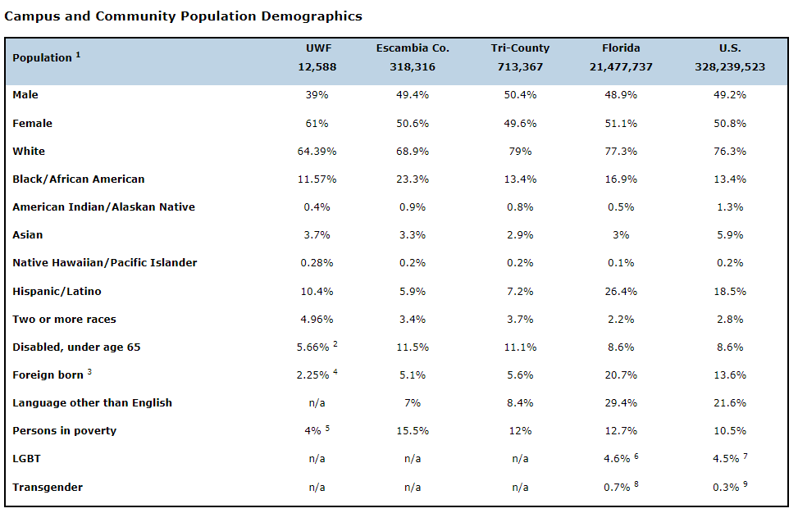
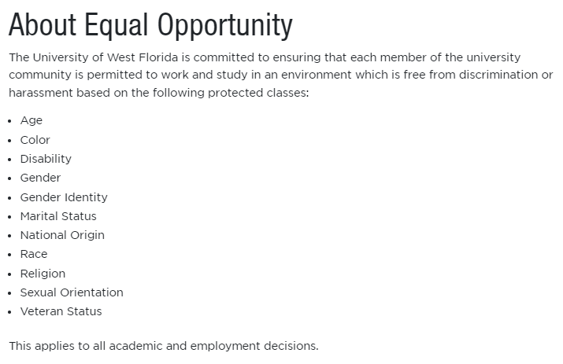
Data Sources
I looked at:
- UWF enrollment demographics
- Census data (local, state, national)
- Protected classes at UWF

Slide 13

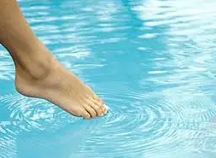
You have to start somewhere,
but not everywhere all at once!

Slide 14
Types of Audits
comprehensive or focused
sampling (1000 or 10%, every 10th book, random generator, etc.)
quantitative or qualitative
user/use-based or collection-based
retrospective or forward-looking
direct collection analysis (shelf analysis)
list checking (or reverse audits)
analysis tools (algorithm - lacks human judgment)
subject headings
usage/circulation stats
lists & displays
orders/new purchases
and more…

Slide 15
3. Count
Do the thing!
What I did…
Notes:
Research the titles

Slide 16
Themes
Diversity can involve a number of factors, including race, ethnicity, gender, sexual identity, culture, language, socioeconomic status, veteran status, religion, politics, age, neurodiversity, and physical abilities.
Themes included:
Race
Ethnicity
Immigration
Gender
Sexual identity
Socioeconomic status
Ability
General/Multidisciplinary
Not included:
#ownvoices/#livedexperiences*
Age
Political diversity
Religious diversity
Veteran status
*
https://diversebooks.org/why-we-need-diverse-books-is-no-longer-using-the-term-ownvoices/

Slide 17
Bowker Book Analysis
Collection Analysis tool
Compare UWF holdings data against Resources for College Libraries (RCL) core titles, using interdisciplinary RCL subjects and relevant LC classification ranges
Advantages: quick turnaround; provides a benchmark; titles lists for collection development
Limitations: requires a subscription; matching errors; reports by call ranges miss interdisciplinarity; broad subject categories; some titles may be out of UWF collection scope

Slide 18
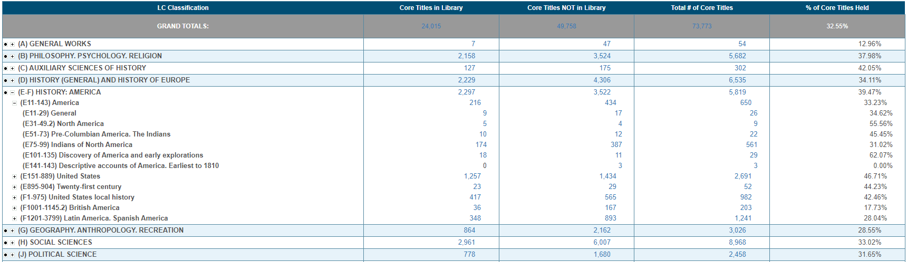
Bowker Book Analysis – LC Ranges
We have 10 out of 22 core titles (45.45%) for ‘Pre-Columbian America. The Indians’
We have 174 out of 561 core titles (31.02%) for ‘Indians of North America’
BUT! E is the Classification for American history, so it may not represent literature, politics, art, health, etc.

Slide 19
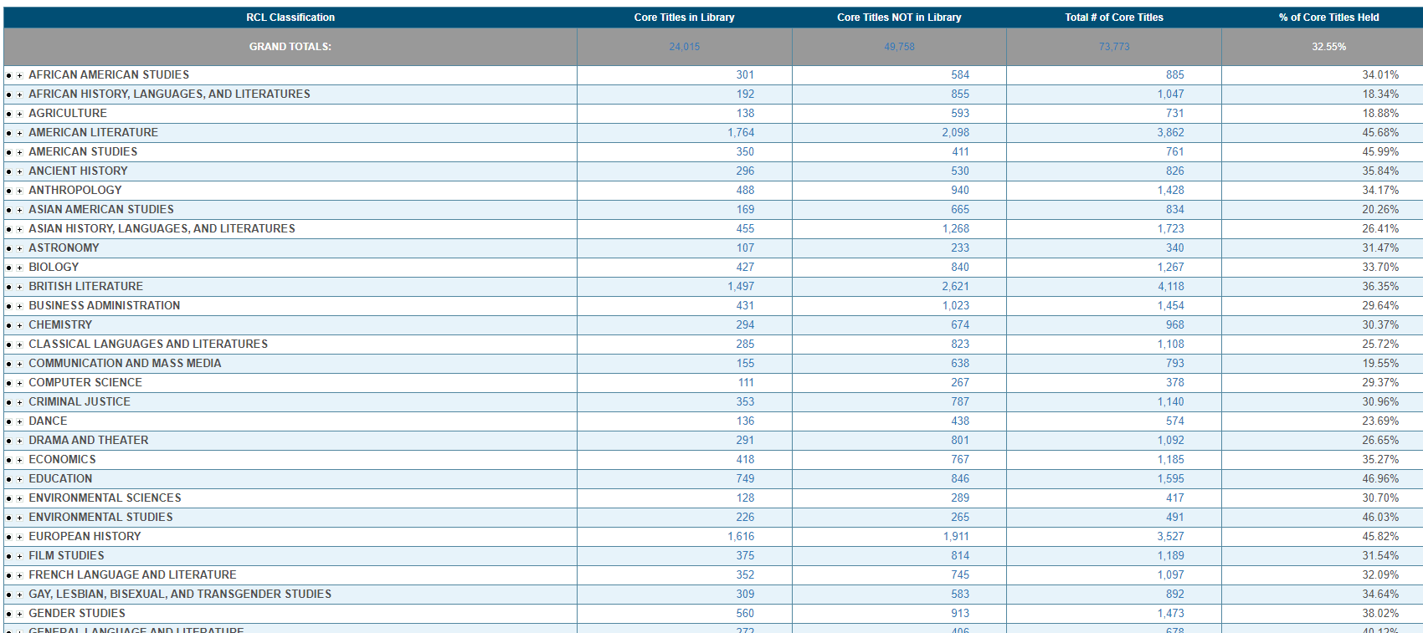
Bowker Book Analysis – RCL Subjects
We have 301 out of 885 core titles (34.01%) for ‘African American Studies’

Slide 20
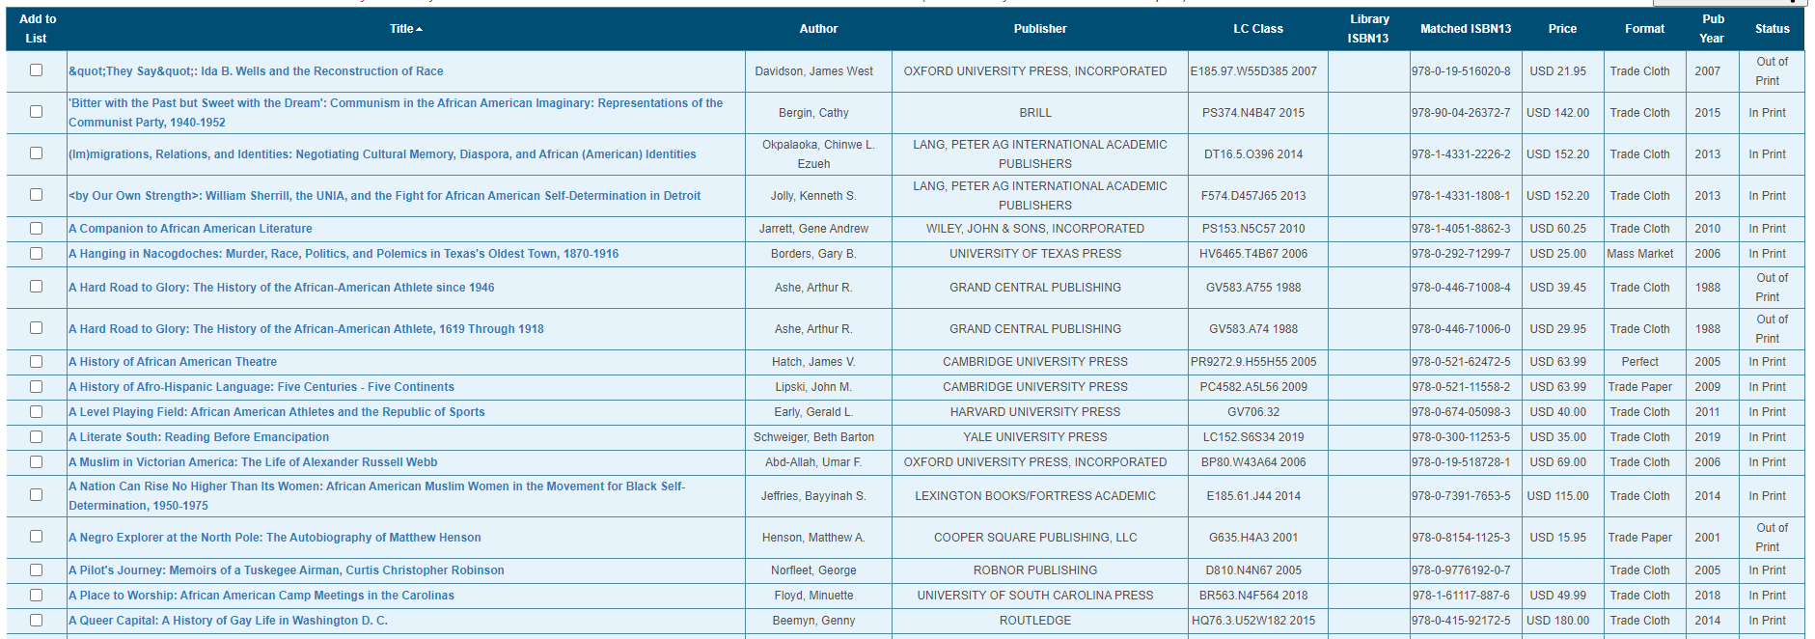
Bowker Book Analysis – RCL Itemized Lists
Core titles NOT in library gives me a list I can use for collection development
Wide variety of call numbers so includes more interdisciplinarity

Slide 21
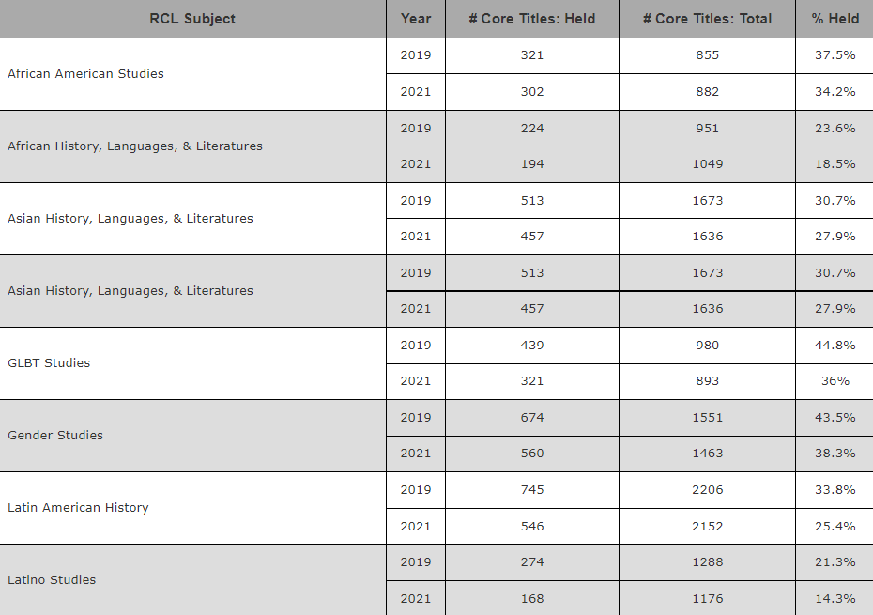
Snapshot of Bowker Analysis Results:
2019 & 2021

Slide 22
GreenGlass Analysis
Collection Analysis tool
Use GreenGlass Sustainable Collection Services to assess age and use of relevant LC classification ranges and compare our holdings to a comparator group of 16 peer and aspirant institutions
Disclaimer: we already had this dataset from another project
Advantages: quick-ish turnaround; provided usage data; comparison to peer and peer-aspirant institutions
Limitations: fee-based; compares what you have to other libraries – it doesn’t tell you what you don’t have; limited to print items with regular circ status; reports by call ranges miss interdisciplinarity; broad subject categories; platforms relying on MARC/OCLC data likely have some margin of error

Slide 23
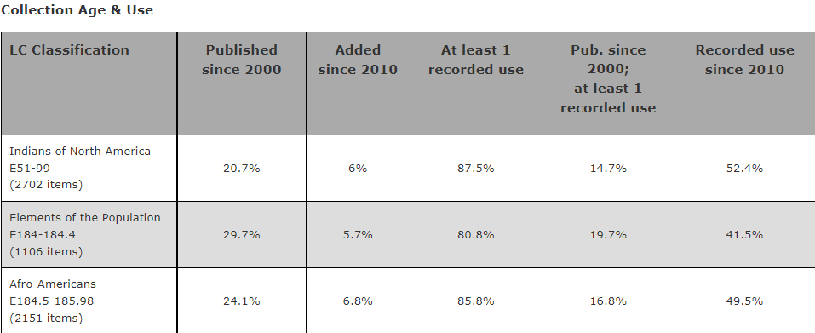
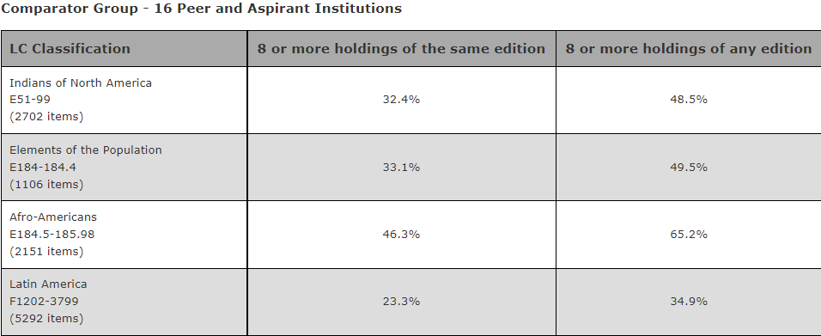
Snapshot of GreenGlass Analysis Results:
November 2019

Slide 24
Diverse Book Awards
List Checking method
Compile lists of last 3 recipients (years) for each award. Compare UWF holdings to determine how many we have in our collection
Advantages: not limited to format or location; title lists for collection development; some vendors allow filtering by included awards
Limitations:
  - up front labor (I had to aggregate my own list of awards)
  - time consuming to compile lists of winners
  - award lists will never be comprehensive
  - majority of awards are for diverse content – few are specific to diverse authors
  - lots of intersectionality
  - most have a humanities/social science theme – other fields not as well represented
  - varied sample sizes – both within and among categories
  - some awards/title may be out of UWF collection scope
  - e-books may be part of a subscription, and thus not intentional purchases

Slide 25
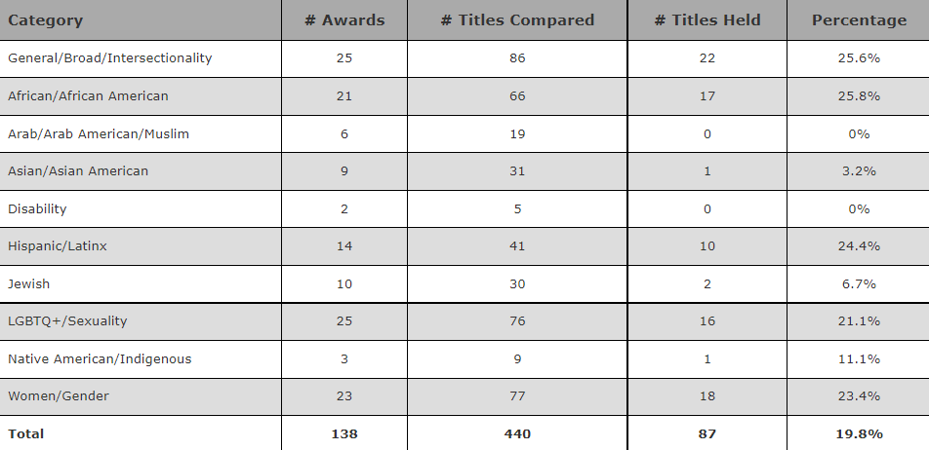
Diverse Book Awards – Snapshot of Results
Diverse Book Awards: https://libguides.uwf.edu/diversebkawds

Slide 26
Diversity Codes
Direct collection analysis
Assign diversity codes to list of fiscal year acquisitions and New Books shelf list to demonstrate how intentional we are (or aren't) about collecting diverse materials.
Assess each book/title individually to determine whether it reflects a measure of diversity (i.e. something other than white, male, nondisabled, and heteronormative)
  - Used title, TOC, and/or subject headings
  - Monographs only (no DVDs, Zines, curriculum materials, or other formats)
  - Content: main topic(s), theme(s), location(s), character(s), etc.
  - not author(s)

Slide 27
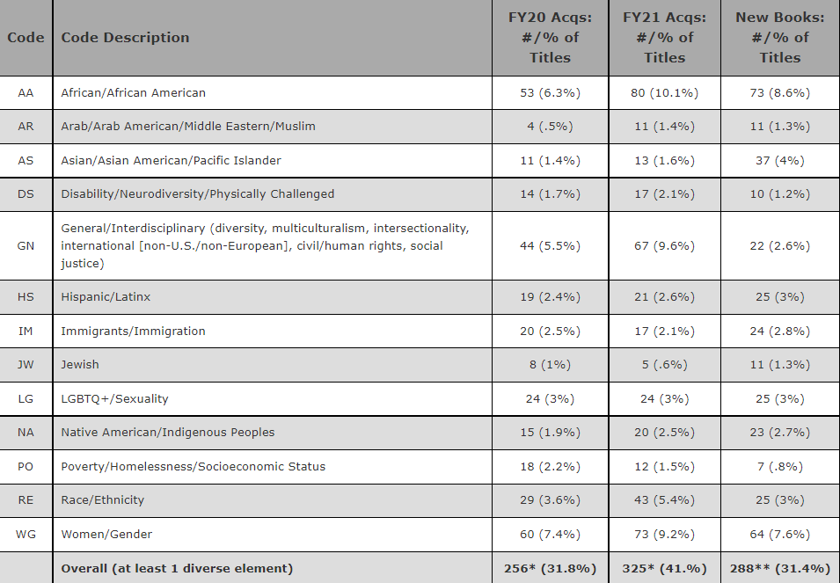
Diversity
Codes/
Categories
New Book Shelflist: n = 844
FY20 acqs: n = 806
FY21 acqs:
n = 794

Slide 28
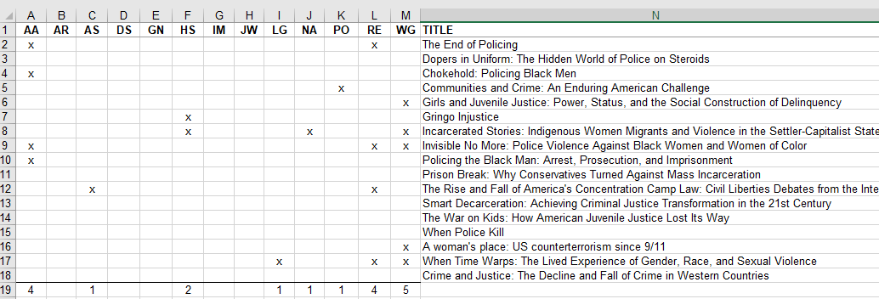
Example: Criminal Justice

Slide 29
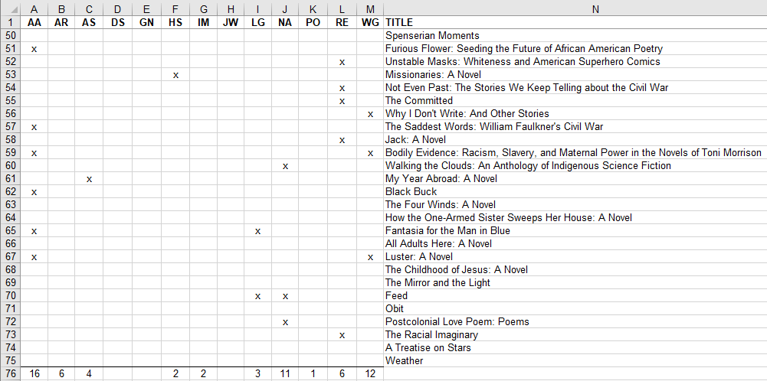
Example: English & Literature

Slide 30
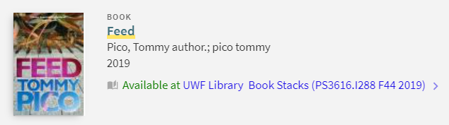
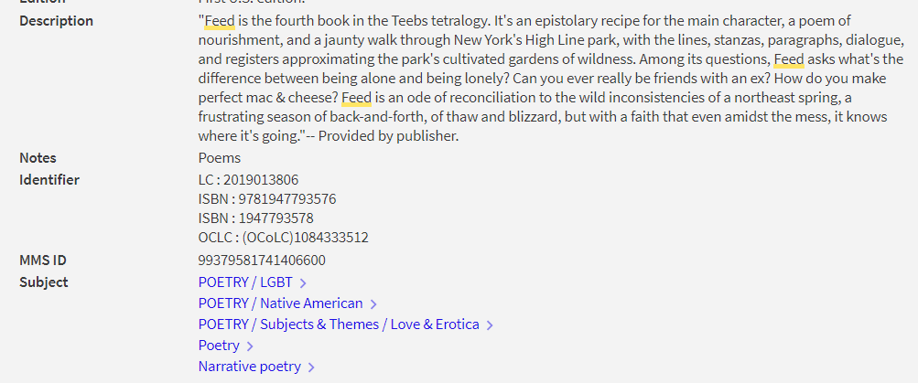

Slide 31
Example Audit Worksheets
short or long, basic or detailed, Word or Excel – whatever works best for you!
https://sfpsmom.com/wp-content/uploads/2015/10/Diverse-Library-Inventory.pdf
https://ready.web.unc.edu/wp-content/uploads/sites/16627/2019/01/Library-Collection-Shelf-Audit-for-Diversity-Inclusion.pdf
https://docs.google.com/spreadsheets/d/1Pllnwj0DbYVgX4L2g_i5c-6brleLceMP/edit#gid=1456641429
https://libraries.vermont.gov/sites/libraries/files/Temp/Diversity%20Audit%20Checklist.pdf
https://www.literacyworldwide.org/docs/default-source/resource-documents/classroomlibraryequityaudit.pdf

Slide 32
4. Analyze
Did you answer your original questions(s)?
Is it better or worse than you expected?
Did you identify any gaps?
How does it stack up against any related demographic data?

Slide 33
5. Act
Visual representations (charts and graphs)
Compile a report (basic to fancy)
Make purchases to address gaps
Set goals and target
Tweak your process for future cycles
Rinse and repeat

Slide 34
How-To Resources
https://teenlibrariantoolbox.com/wp-content/uploads/2017/11/Diversity-Audit-Outline-2017-with-Sources.pdf
https://teenlibrariantoolbox.com/2017/11/02/doing-a-ya-collection-diversity-audit-part-2/
https://dontyoushushme.com/2020/06/15/diversity-audit-a-practical-guide/
https://www.libraryjournal.com/story/Counting-the-Collection-Conducting-a-Diversity-Audit-of-Adult-Biographies
https://libguides.ctstatelibrary.org/dld/children/inclusivecollections
https://cod-lis.libguides.com/c.php?g=1144450&p=8354287

Slide 35
Takeaways
no single method is “right” or comprehensive
mixed methods approach is recommended if doable
it won’t be perfect – but some data is always better than no data
every little bit helps and lays the groundwork for future success
don’t let the perfect be the enemy of the good (be kind to yourself)
see what works and what doesn’t, and tweak as you go
maintain awareness of intersectionality and interdisciplinarity
human fallibility - subject content and interpretation can be subjective
but automated processes lack that human element

Slide 36

THANKS!
Questions:
Melissa Gonzalez
mgonzalez@uwf.edu
Project site: https://libguides.uwf.edu/divassess
Credit: slide template by SlidesCarnival

