Slide 1

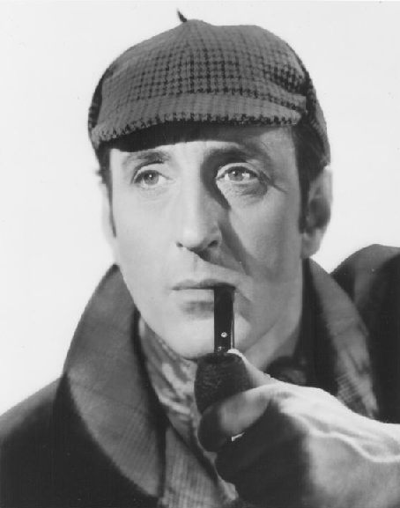
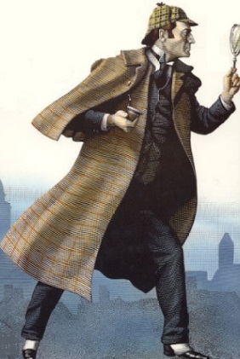

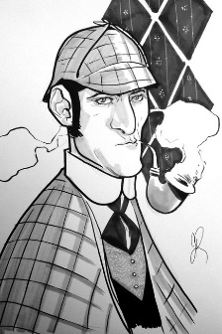

Sherlock Holmes:
The History, The Influence, The Methods
Featuring:
Regina Stinson, BSI, ASM
Thursday
October 2nd, 2014
7:00 PM
Graubner Library
65821
Van Dyke
Washington, MI 48095

