Slide 1

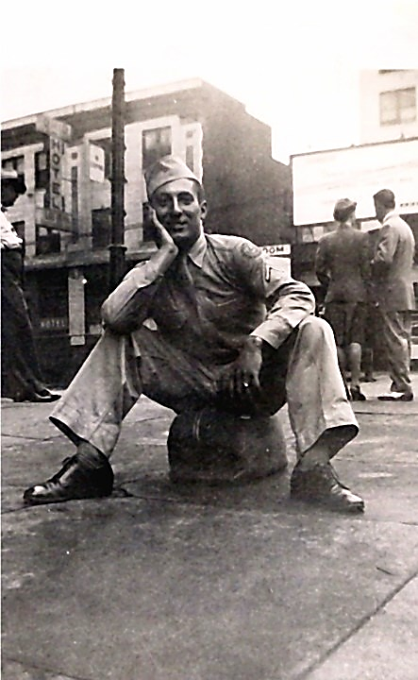

Wednesday / April 27, 2016 / 2:00 p.m.
Croton Township Library presents
A Thousand Letters Home…the Journey of the Letters
Author Teresa Irish takes you on a captivating and life-affirming journey based on the 1,000 letters her father wrote home from WWII. Her skillful, engaging storytelling blends humor and history to leave audiences laughing, crying, reminiscing and inspired. A heartfelt tribute to America’s history, freedoms, and family values, as well as a call to citizenship in today’s world, Irish’s presentation reaches across generations with a little something for everyone. With over 220 prior venues and numerous enthusiastic reviews, this is a program you won’t want to miss! www.AThousandLettersHome.com
Croton Township Library - 8260 S. Croton-Hardy Drive, Newaygo, MI
www.crotonlibrary.org or 231-652-1615
"This activity is supported by the MICHIGAN COUNCIL FOR ARTS AND CULTURAL AFFAIRS and the NATIONAL ENDOWMENT FOR THE ARTS."

