Slide 1
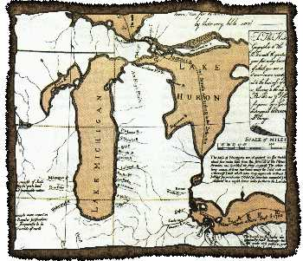
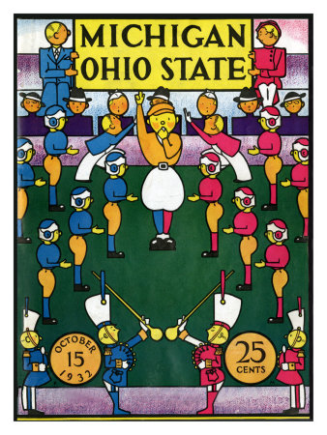
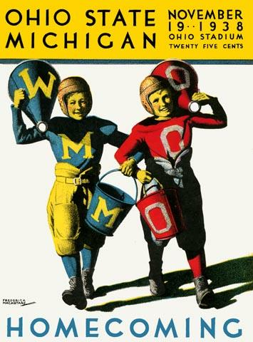
The Toledo War
“The Start of the
Great Michigan-Ohio Rivalry”
Join us for an informative presentation from
research librarian and author Alan Naldrett!
Free refreshments will also be served.
WEDNESDAY,
SEPTEMBER 18, 2013
7:00 PM
Romeo District Library –
Graubner Library
65821 Van Dyke
Washington, MI 48095
586-752-0603

Slide 2
“The Toledo War: The Start of the Great Michigan-Ohio Rivalry” Join us for an informative presentation from research librarian and author Alan Naldrett! Free refreshments will also be served. WEDNESDAY, SEPTEMBER 18, 2013 7:00 PM Romeo District Library – Graubner Library 65821 Van Dyke Washington, MI 48095 586-752-0603 | “The Toledo War: The Start of the Great Michigan-Ohio Rivalry” Join us for an informative presentation from research librarian and author Alan Naldrett! Free refreshments will also be served. WEDNESDAY, SEPTEMBER 18, 2013 7:00 PM Romeo District Library – Graubner Library 65821 Van Dyke Washington, MI 48095 586-752-0603
“The Toledo War: The Start of the Great Michigan-Ohio Rivalry” Join us for an informative presentation from research librarian and author Alan Naldrett! Free refreshments will also be served. WEDNESDAY, SEPTEMBER 18, 2013 7:00 PM Romeo District Library – Graubner Library 65821 Van Dyke Washington, MI 48095 586-752-0603 | “The Toledo War: The Start of the Great Michigan-Ohio Rivalry” Join us for an informative presentation from research librarian and author Alan Naldrett! Free refreshments will also be served. WEDNESDAY, SEPTEMBER 18, 2013 7:00 PM Romeo District Library – Graubner Library 65821 Van Dyke Washington, MI 48095 586-752-0603

